Slide 1
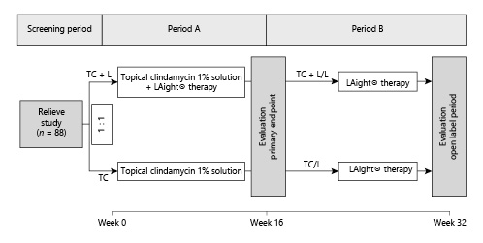
LAight® Therapy Is an Effective Treatment Option to Maintain Long-Term Remission of Hurley I and II Hidradenitis Suppurativa: Results from Period B of RELIEVE, a Multicenter Randomized, Controlled Trial
Dermatology - DOI:10.1159/000524739
© 2022 The Author(s). Published by S. Karger AG, Basel - CC BY 4.0
Notes:
Fig. 1. RELIEVE study design. The work at hand does report the results of period B, while period A outcomes were already reported in a preceding paper.

Slide 2
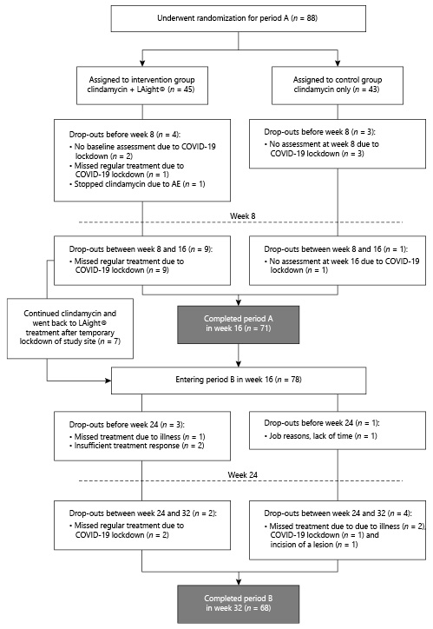
LAight® Therapy Is an Effective Treatment Option to Maintain Long-Term Remission of Hurley I and II Hidradenitis Suppurativa: Results from Period B of RELIEVE, a Multicenter Randomized, Controlled Trial
Dermatology - DOI:10.1159/000524739
© 2022 The Author(s). Published by S. Karger AG, Basel - CC BY 4.0
Notes:
Fig. 2. CONSORT flow diagram.

Slide 3
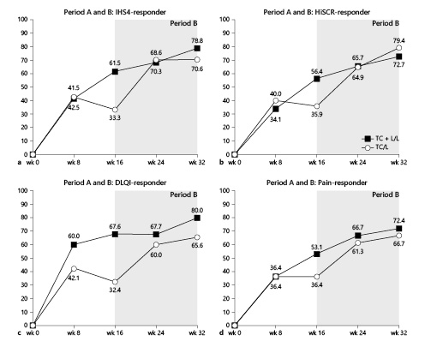
LAight® Therapy Is an Effective Treatment Option to Maintain Long-Term Remission of Hurley I and II Hidradenitis Suppurativa: Results from Period B of RELIEVE, a Multicenter Randomized, Controlled Trial
Dermatology - DOI:10.1159/000524739
© 2022 The Author(s). Published by S. Karger AG, Basel - CC BY 4.0
Notes:
Fig. 3. a–d Development of response rates in IHS4, HiSCR, DLQI, and pain-NRS from baseline to week 32 (due to the inclusion of the additional seven period A drop-outs in the period B analysis, values in week 8 and 16 of the TC + L/L slightly differ from the reported endpoint analysis in the period A publication [22]).

Slide 4
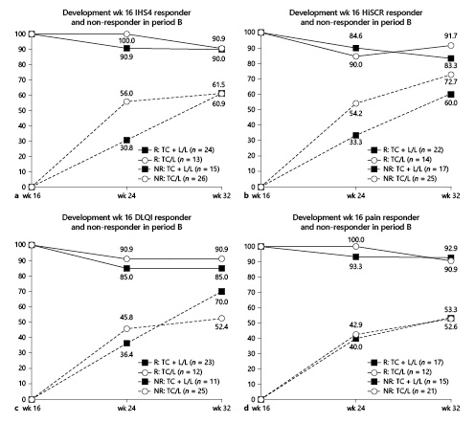
LAight® Therapy Is an Effective Treatment Option to Maintain Long-Term Remission of Hurley I and II Hidradenitis Suppurativa: Results from Period B of RELIEVE, a Multicenter Randomized, Controlled Trial
Dermatology - DOI:10.1159/000524739
© 2022 The Author(s). Published by S. Karger AG, Basel - CC BY 4.0
Notes:
Fig. 4. a–d Development of response rates in IHS4, HiSCR, DLQI, and pain-NRS from week 16 to week 32; for week-16 responders (R) starting at 100% and week-16 nonresponders (NR) starting at 0%.

Slide 5
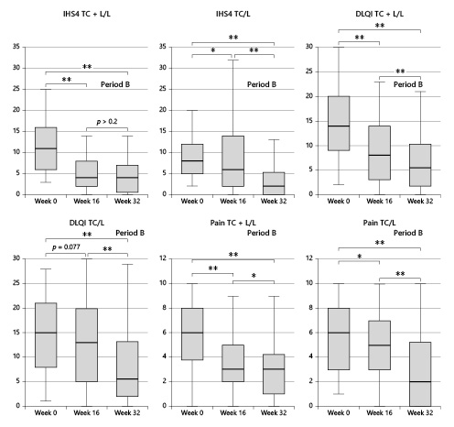
LAight® Therapy Is an Effective Treatment Option to Maintain Long-Term Remission of Hurley I and II Hidradenitis Suppurativa: Results from Period B of RELIEVE, a Multicenter Randomized, Controlled Trial
Dermatology - DOI:10.1159/000524739
© 2022 The Author(s). Published by S. Karger AG, Basel - CC BY 4.0
Notes:
Fig. 5. Development of median in IHS4, DLQI, and pain-NRS from baseline to week 32; where * stands for a p value ≤0.05 and ** stands for a p value ≤0.01 when applying the Wilcoxon signed-rank test (due to the inclusion of the additional seven period A drop-outs in the period B analysis, values in week 8 and 16 of the TC + L/L slightly differ from the reported endpoint analysis in the period A publication [22]).

Slide 6
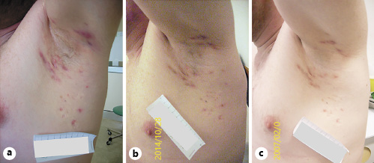
LAight® Therapy Is an Effective Treatment Option to Maintain Long-Term Remission of Hurley I and II Hidradenitis Suppurativa: Results from Period B of RELIEVE, a Multicenter Randomized, Controlled Trial
Dermatology - DOI:10.1159/000524739
© 2022 The Author(s). Published by S. Karger AG, Basel - CC BY 4.0
Notes:
Fig. 6. Manifestation of HS lesions in the right axilla of a participant of the TC + L/L at baseline (a), at time of primary endpoint evaluation at week 16 (b), and after open-label period B at week 32 (c).

Slide 7
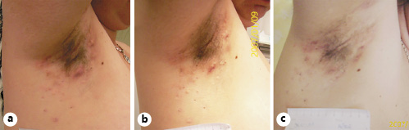
LAight® Therapy Is an Effective Treatment Option to Maintain Long-Term Remission of Hurley I and II Hidradenitis Suppurativa: Results from Period B of RELIEVE, a Multicenter Randomized, Controlled Trial
Dermatology - DOI:10.1159/000524739
© 2022 The Author(s). Published by S. Karger AG, Basel - CC BY 4.0
Notes:
Fig. 7. Manifestation of HS lesions in the right axilla of a participant of the TC/L at baseline (a), at time of primary endpoint evaluation at week 16 (b), and after open-label period B at week 32 (c).

